Slide 1

MACHINE LEARNING BASED
CHRONIC KIDNEY DISEASE PREDICTION
WITH SMART WEB APPLICATION
Project Guide:
Dr. Vidivelli S
Asst.Professor-II-SOC
126018042 - Sanjai S

Slide 2
OUTLINE
Motivation
Objective
Base Paper
Problem Statement
Literature Survey
Dataset
Work Plan
Modules
Proposed Architecture
References

Slide 3
MOTIVATION
Chronic Kidney Disease (CKD) is an emerging global health issue with a rising number of cases.
CKD can strike individuals of all ages, hence the importance of early detection.
Recent breakthroughs in machine learning have enhanced healthcare diagnostics and predictive models.
A web-based system provides instant access to CKD prediction for medical professionals.
The primary focus here is to create an effective CKD prediction system.

Slide 4
OBJECTIVE
To identify the most effective feature selection techniques for better diagnosis.
To choose the best classification algorithms for accurate CKD prediction.
An approach to predict Chronic Kidney Disease (CKD) with improved accuracy.
A web-based system ensures quick access to CKD prediction for healthcare providers.

Slide 5
BASE PAPER
Rajib Kumar Halder, Mohammed Nasir Uddin, Md. Ashraf Uddin, Sunil Arya, Sajeeb Saha, Rakib Hossen, Sabbir Ahmed, Mohammad Abu Tareq Rony & Mosammat Farida Akter, “ML-CKDP: Machine learning-based chronic kidney disease prediction with smart web application”, Journal of Pathology Informatics.
Indexed in: Scopus
Year: 2024

Slide 6
PROBLEM STATEMENT
To enhance the accuracy of the existing machine learning model for improved predictive analysis.

Slide 7
LITERATURE REVIEW
YEAR | AUTHORS | TITLE | MODELS | ACCURACY | LIMITATIONS
2021 | Andrew P. Bradley [1] | The use of the area under the ROC curve in the evaluation of machine learning algorithms | KNN | 74.2 % | Results are valid only for the tested configurations.
2021 | Mohammed Nasir Uddin et al.[2] | An ensemble method based multilayer dynamic system to predict cardiovascular disease using machine learning approach. | XGB LR SVM KNN DT | 73.66 % 70.56 % 71.97 % 68.92 % 62.84 % | Very limited number of features were used for the prediction.
2022 | Sibo Prasad Patro et al. [3] | Classification model for heart disease prediction using correlation and feature selection techniques | SVM | 67% | Applying oversampling techniques led to a drop in accuracy
Notes:
1.This makes it unfit for assisting clinicians in the risk for an patient.
2.They used only 11 features which fails to extract the hidden pattern and improve the detection accuracy.

Slide 8
LITERATURE REVIEW
YEAR | AUTHORS | TITLE | MODELS | ACCURACY | LIMITATIONS
2023 | Rahul Sawhney [4] | A comparative assessment of artificial intelligence models used for early prediction and evaluation of chronic kidney disease | SVM | 81 % | Small and highly specific dataset is used
2022 | Ramesh Chandra Poonia et al. [5] | Intelligent Diagnostic Prediction and Classification Models for Detection of Kidney Disease | KNN ANN | 66.25% 65% | Dataset used for training and evaluation contains data from a specific demographic
2022 | Md Mahedi Hassan et al. [6] | An Ensemble Learning Approach for Chronic Kidney Disease Prediction Using Different Machine Learning Algorithms with Correlation Based Feature Selection | KNN SVM | 87.29 % 89.17 % | Correlation method used may not be ideal for non-linear relationships.
Notes:
1.This makes it unfit for assisting clinicians in the risk for an patient.
2.They used only 11 features which fails to extract the hidden pattern and improve the detection accuracy.
3. Mahedi - CBFS(Cubic bipolar fussy sets) may not be ideal for non-linear relationships, as Pearson correlation mainly captures linear dependencies.

Slide 9
LITERATURE REVIEW
YEAR | AUTHORS | TITLE | MODELS | ACCURACY | LIMITATIONS
2022 | Dibaba Adeba Debal et al.[7] | Chronic kidney disease prediction using machine learning techniques | XGB | 82.56% | Traditional machine learning models
2010 | Li-min Wang et al. [8] | Feature Selection and Prediction of Sub-health State Using SVM-RFE | SVM | 80.35% | Uses only one feature selection method
2022 | Pronab Ghosh et al. [9] | Efficient Prediction of Cardiovascular Disease Using Machine Learning Algorithms With Relief and LASSO Feature Selection Techniques | KNN | 83.61 | High level of missing values in the dataset
Notes:
1.This makes it unfit for assisting clinicians in the risk for an patient.
2.They used only 11 features which fails to extract the hidden pattern and improve the detection accuracy.

Slide 10
DATASET
Dataset Overview
Name: Chronic Kidney Disease (CKD) Dataset
Source: UCI Machine Learning Repository
Number of Records: 400
Number of Features: 25 (both numerical and categorical)
Data Types:
Numerical: Age, blood pressure, serum creatinine, sodium, potassium, hemoglobin, etc.
Categorical: Presence of diabetes, hypertension, anemia, etc.
Binary Labels: ckd (chronic kidney disease) or not ckd (no kidney disease).
Data Quality & Integrity
Missing Values: Some features have missing values, especially rbcc and wbcc.
Duplicates: No duplicates in the dataset.
Outliers & Anomalies: Some extreme values in sc (serum creatinine) and bu (blood urea).

Slide 11
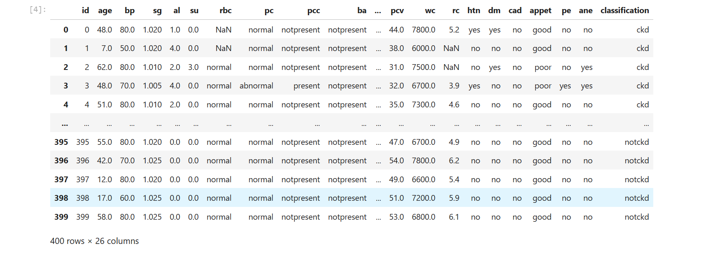
DATASET

Slide 12
WORKPLAN
IDEATION
ZERO REVIEW
1ST REVIEW
2ND REVIEW
FINAL REVIEW
Understanding the approach towards the problem
Literature review and a implementable roadmap
Implementation of modules sequentially as described in the proposed model
Learning flask and integrating prepared models with web frontend

Slide 13
MODULES
MODULE 1: DATA PREPROCESSING
  Label Encoding
  Handling Missing Values
  Data Scaling
MODULE 2: FEATURE SELECTION
  FILTER METHOD
    Correlation
    Chi square
    Variance Threshold
  WRAPPER METHOD
    Recursive Feature Elimination
    Sequential Forward Selection

Slide 14
MODULES
c)EMBEDDED METHOD
(i) Lasso
(ii) Ridge Regression
3) MODULE 3: CROSS VALIDATION AND TRAIN TEST SPLIT
k-fold cross validation
Train test split method
4) MODULE 4: MODEL BLADING
RF
Gradient Boosting
AdaBoost
XgBoost
Naive Bayes
Support Vector Machine
Decision Tree

Slide 15
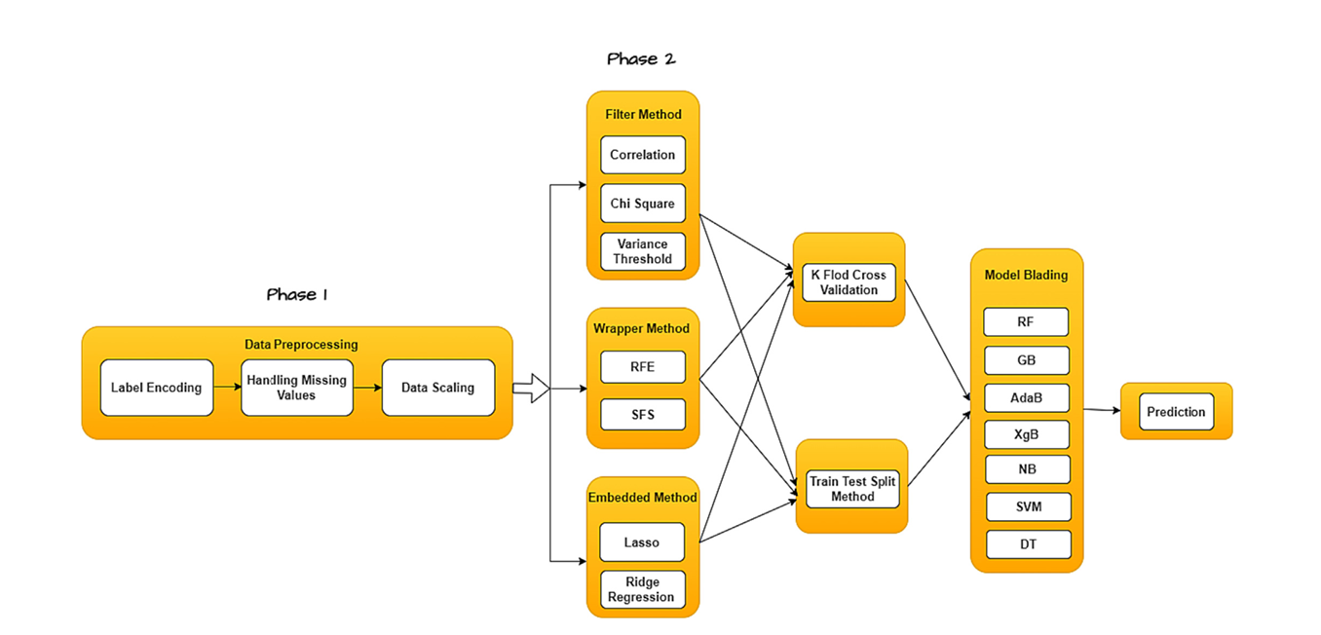
PROPOSED ARCHITECTURE

Slide 16

REFERENCES
[1] Bradley AP. The use of the area under the ROC curve in the evaluation of machine learning algorithms. Pattern Recognit 1997;30(7):1145–1159 - https://doi.org/10.1016/S0031-3203(96)00142-2
[2] Uddin MN, Halder RK. An ensemble method based multilayer dynamic system to predict cardiovascular disease using machine learning approach. Informatics in Medicine Unlocked 2021;24:100584 - https://doi.org/10.1016/j.imu.2021.100584
[3] Patro S. P., Padhy N., and Sah R. D., "Classification model for heart disease prediction using correlation and feature selection techniques," in 2022 OITS International Conference on Information Technology (OCIT), Bhubaneswar, India, 14-16 Dec. 2022. IEEE, 2023 - https://ieeexplore.ieee.org/document/10053797/authors#authors
[4] Sawhney R, et al. A comparative assessment of artificial intelligence models used for early prediction and evaluation of chronic kidney disease. Decision Analyst J 2023;6,100169 - https://doi.org/10.1016/j.dajour.2023.100169
[5] Poonia RC, Gupta MK, Abunadi I, et al. Intelligent diagnostic prediction and classification models for detection of kidney disease. Healthcare 2022;10:371.- https://doi.org/10.3390/healthcare10020371

Slide 17
REFERENCES
[6] Hassan MM, Ahamad T, Das S. An ensemble learning approach for chronic kidney disease prediction using different machine learning algorithms with correlation based feature selection. 2022 25th International Conference on Computer and Information Technology (ICCIT), Cox’s Bazar, Bangladesh; 2022. p. 242–247 - https://doi.org/10.1109/ICCIT57492.2022.10055471
[7] Debal D. A. and Sitote T. M., "Chronic kidney disease prediction using machine learning techniques," Journal of Big Data, vol. 9, article 109, 20 Nov. 2022 - https://journalofbigdata.springeropen.com/articles/10.1186/s40537-022-00657-5
[8] Wang L-m, Chen J-x, Pei Y, Zhao X, Cui H-t, Cui H-z. Feature selection and prediction of sub-health state using SVM-RFE. 2010 International Conference on Artificial Intelligence and Computational Intelligence, Sanya, China; 2010. p. 199–202 - https://doi.org/10.1109/AICI.2010.280
[9] Newaz A, Muhtadi S. Performance improvement of heart disease prediction by identifying optimal feature sets using feature selection technique. 2021 International Conference on Information Technology (ICIT), Amman, Jordan; 2021. p. 446–450 - https://doi.org/10.1109/ICIT52682.2021.9491739

Slide 18
THANK YOU

